Slide 1
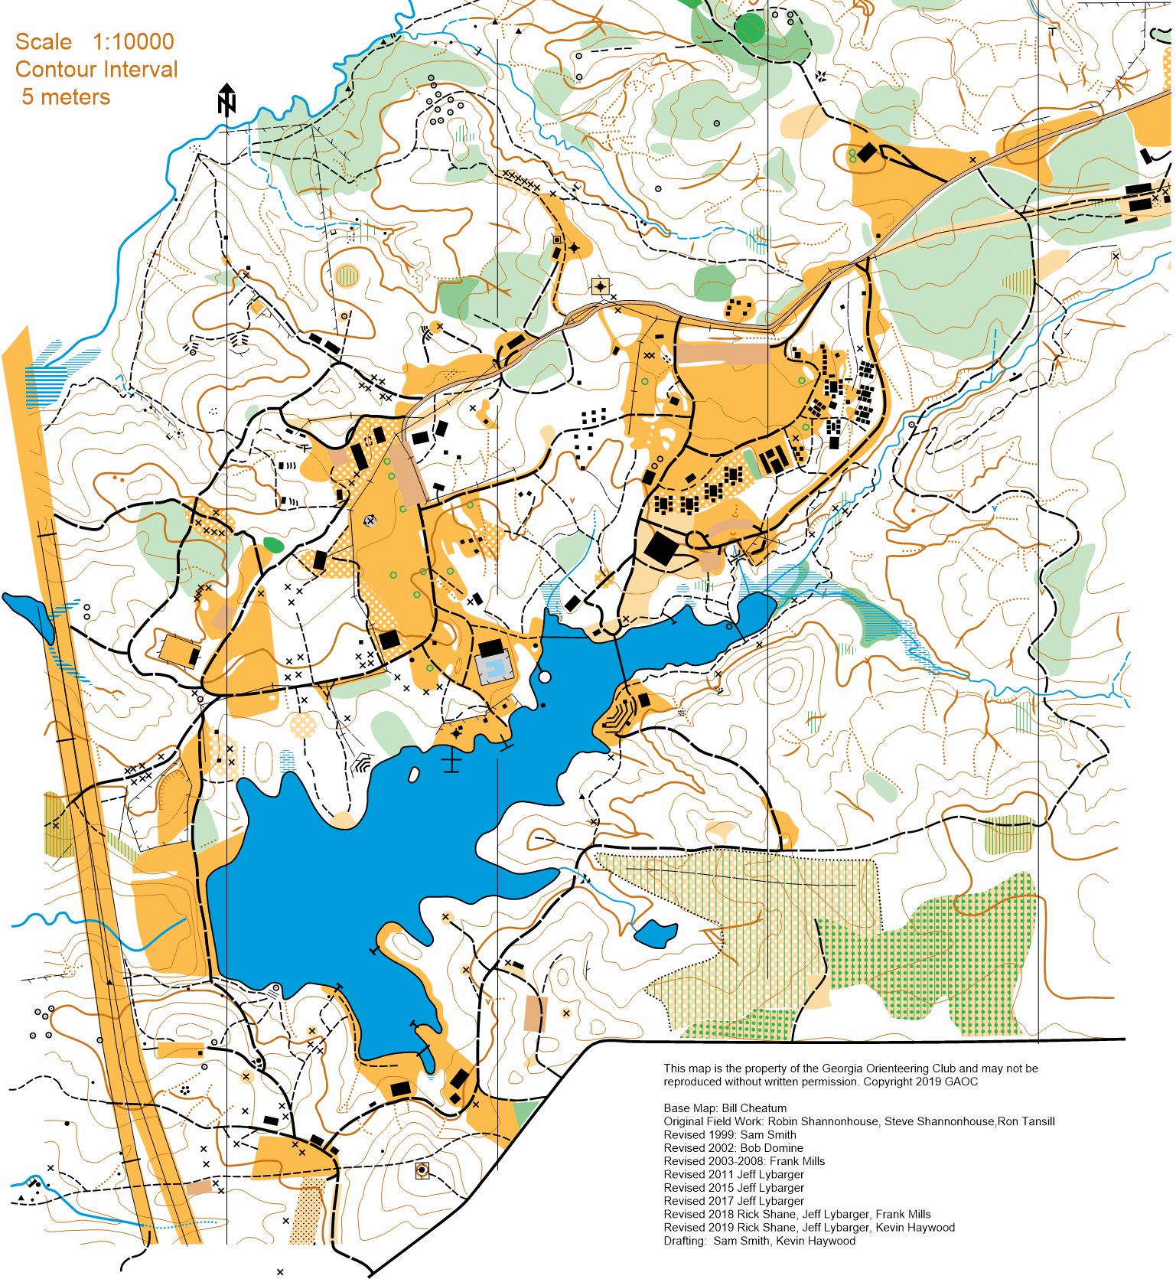
Bert Adams Scout Reservation
500 m

