Slide 1
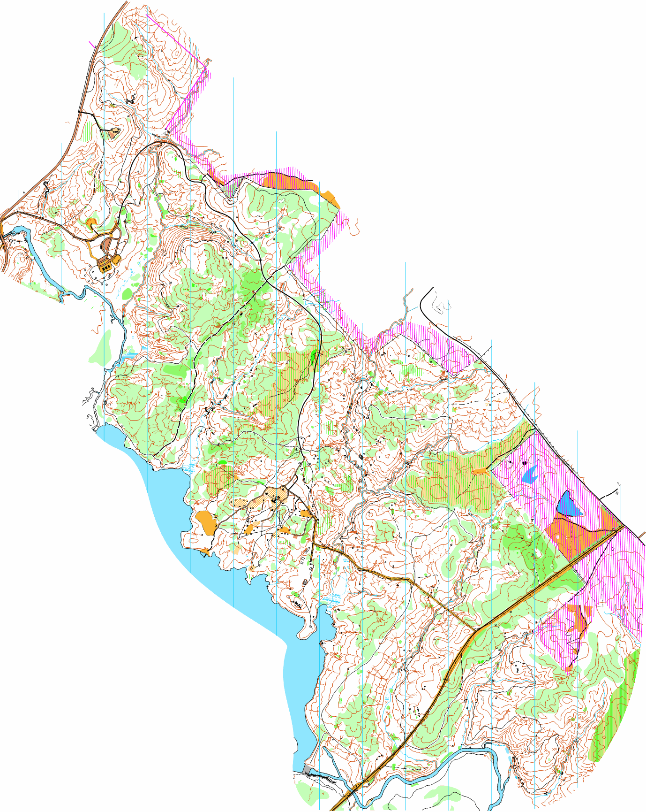
Camp Rutledge
Scale 1:10000
Contours 2.5 m
500 m

